Slide 1
Big Data
Hadoop
Introduction

Slide 2
Contents
Big Data – Definitions, Significance
Hadoop – Architecture
HDFS – Overview

Slide 3
What is Big Data
A catch-phrase used to describe a massive volume of both structured and unstructured data that is so large that it's difficult to process using traditional database and software techniques.
“Big data is high volume, high velocity, and high variety information assets that require new forms of processing to enable enhanced decision making, insight, discovery, and process optimization.”
Amazon was averaging about 26.5 million transactions per day, over a million transactions per hour that translates into roughly 2.5 peta bytes an hour.
Flipkart was averaging 45,000 transactions a day.
Google processes 20 PB’s of information per day.

Slide 4
Why – Big Data
Businesses have thrived on their ability to derive insights from information or data.
It has helped them make better, smarter, real time, and fact-based decisions.
This demand for intensity of knowledge is what has fueled the growth of “big data.”
Data has grown exponentially with the advent of social media and mobile technology.
There is hardly any field that is not likely to be benefited by “big data” initiatives.
Big data is definitely expected to lay the foundation for advancements in health care, medicine, data analysis, scientific research, education, energy, transportation, financial services, retail, and the telecommunications industry.

Slide 5
Why – Big Data
Competitive advantage:
  Amazon has better recommendation system because of user data.
  For LinkedIn, Facebook – analysis of networking data is the competitive advantage.
Better User Experience:
  Telecom services improve network by analysis call data
  Facebook/Whatsapp improves product by analyzing logs
  Companies prefer implicit feedback rather than explicit feedback
  Less churn – Predicting customer loyalty
Necessity:
  Flipkart sold 1 lakh moto-e sets in a few minutes
  Companies need to be prepared from day-1
  A new application can go viral overnight, users increase from a few dozens to thousands or millions

Slide 6
Why – Big Data
RDBMS
  Highly structured data
  Organized into flat tables of rows and columns
  Normalized and relationships defined across tables
Drawbacks
  Scaling
  Supporting large number of concurrent users
  Performance slows down and response times deteriorate
  Vertical scaling is possible and not designed for horizontal scaling
  Variety aspect of data – Cannot handled semi-structured and unstructured data

Slide 7
Hadoop – History
In 2002-04 Doug Cutting with Mike Cafarella started working on Nutch – an open source project
In 2003-04 Google published papers on Google File System and MapReduce which are implemented in Nutch
In 2006 they formed Hadoop project; around the same time Doug Cutting joined Yahoo! which provided him a team for full-fledged development of Hadoop
In January 2008, Hadoop was made its own top-level project at Apache

Slide 8
What is Hadoop?
Apache Hadoop is a software framework that allows for the distributed processing of large data sets across clusters of computers using simple programming models.
Designed to scale up from single servers to thousands of machines, each offering local computation and storage.
Designed to detect and handle failures at the application layer, so delivering a highly-available service on top of a cluster of computers, each of which may be prone to failures.
Hadoop provides – a reliable, scalable platform for storage and analysis of large amounts of data on clusters of commodity machines.
These machines typically run Linux operating system (OS).
Built using the Java language; any cluster of machines that supports Java can run Hadoop.

Slide 9
What is Hadoop?
Components of Hadoop
  Hadoop 1.0
    HDFS – Distributed storage
    MapReduce – Distributed processing
  Hadoop 2.0
    HDFS - Distributed storage
    Distributed Processing
      YARN - Resource management
      MapReduce - Distributed computation

Slide 10
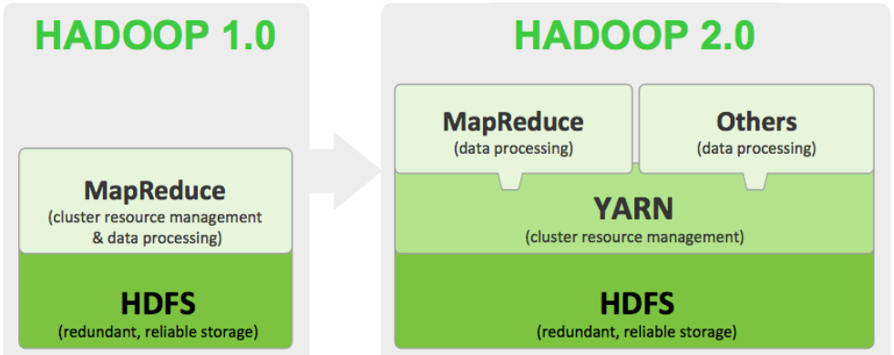
What is Hadoop?
Hadoop 1.0 and Hadoop 2.0

Slide 11
Hadoop Distributed File System (HDFS)
HDFS is a highly fault-tolerant file system designed to run on clusters of commodity hardware.
Provides high throughput access to application data and is suitable for applications that have large data sets.
HDFS is designed more for batch processing rather than interactive use by users.
HDFS is built for write-once, read-many-times pattern of data processing.
Files in HDFS are divided into blocks and written across the cluster nodes by a single writer. Writes are always made at the end of the file, in append-only fashion.
Each block is 128 MB by default; block size is configurable.
Every block is replicated 3 times by default on different nodes of the cluster. Replication factor is configurable.
Replication provides fault-tolerance to the system.

Slide 12
HDFS
HDFS has a master/slave architecture.
On master node runs the background process NameNode. On slave nodes the background called DataNode runs.
The NameNode and DataNode are pieces of software designed to run on commodity machines. These machines typically run a GNU/Linux operating system (OS).
Master server or NameNode manages the file system namespace and regulates access to files by clients.
DataNode which are the workhorses of the cluster stores the actual data which is divided into blocks.
HDFS supports a traditional hierarchical file organization. A user or an application can create directories and store files inside these directories.
The file system namespace hierarchy is similar to other existing file systems; one can create and remove files, move a file from one directory to another, or rename a file.
HDFS supports access permissions and user quotas.

Slide 13
HDFS
NameNode maintains the file system tree and the metadata for all the files and directories in the tree.
This information is stored persistently on the local disk in the form of two files: the namespace image and the edit log.
The namenode also knows the datanodes on which all the blocks for a given file are located; however, it does not store block locations persistently, because this information is reconstructed from datanodes when the system starts.
Executes file system namespace operations like opening, closing, and renaming files and directories.
It determines mapping of blocks to DataNodes.

Slide 14
HDFS
Datanodes are the work-horses of the filesystem and store the actual data.
Responsible for serving read and write requests from the file system’s clients.
Also perform block creation, deletion, and replication upon instruction from the NameNode.
Periodically send a Heartbeat and a Blockreport to NameNode.
Heartbeat indicates that the DataNode is functioning properly. A Blockreport contains a list of all blocks on a DataNode.
A client accesses the filesystem on behalf of the user by communicating with the namenode and datanodes.

Slide 15
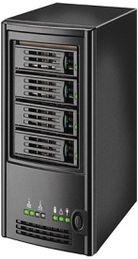
Hadoop Distributed File System (HDFS)
Worker
Datanode
Worker
Datanode
2
5
5
2
4
1
1
Master
Namenode
Worker
Datanode
2
1
3
HDFS
4
4
3
5
Worker
Datanode
Worker
Datanode
4
3
3
1
2
5

Slide 16
HDFS
A secondary namenode, is run whose main role is to periodically merge the namespace image with the edit log to prevent the edit log from becoming too large.
The secondary namenode usually runs on a separate physical machine because it requires plenty of CPU and as much memory as the namenode to perform the merge. It keeps a copy of the merged namespace image, which can be used in the event of the namenode failing.
The namenode is still a single point of failure (SPOF) in Hadoop 1.0
Each cluster had a single NameNode, and if that machine or process became unavailable, the cluster as a whole would be unavailable until the NameNode was either restarted or brought up on a separate machine.
To recover from a failed namenode in this situation, an administrator starts a new primary namenode with one of the filesystem metadata replicas and configures datanodes to use this new namenode.

Slide 17
HDFS
Prior to Hadoop 2.0 NameNode was a Single Point Of Failure. This has been remedied in Hadoop 2.0 and above by adding support for HDFS High Availability.
HDFS High Availability feature provides the option of running two (or more, as of Hadoop 3.0.0) redundant NameNodes in the same cluster in a standby configuration.
Datanodes send block reports to both namenodes because the block mappings are stored in a namenode’s memory, and not on disk.
The namenodes use highly available shared storage to share the edit log.
There are two choices for the highly available shared storage: an NFS filer, or a quorum journal manager (QJM).
If the active namenode fails, the standby can take over very quickly (in a few tens of seconds) because it has the latest state available in memory: both the latest edit log entries and an up-to-date block mapping.
Automatic failover is enabled by two additional components – Zookeeper quorum and ZooKeeper Failover Controller which monitor the health of NamaNodes and elect another Namenode as failover alternative if the active one goes down.

Slide 18
HDFS – Commands
Web UI:
  https://<ip address>:50070
$ hadoop version
$ hadoop fs -ls /
$ hadoop fs -ls
$ hadoop fs -mkdir <directory name>
$ hadoop fs -copyFromLocal <filename>
$ hadoop fs -put <directory>/<file name>
$ hadoop fs –copyToLocal <file name>
$ hadoop fs –get <directory>/<file name>
$ hadoop dfs -cat test2.txt
$ hadoop dfs -tail test3.txt ➔ Displays last KB of file

Slide 19
HDFS – Commands
$ hadoop fs –rm <file name>
$ hadoop fs –rm -r <directory>
$ hadoop fs –mv <dir1/filename1> <dir2/filename2>
$ hadoop fs –cp <dir1/filename1> <dir2/filename2>
  $ hadoop fs -expunge
$ hadoop fs -chmod a+r test3.txt → Give read permissions to all for the file test3.txt
$ hadoop fs –chmod go-w test3.txt → Remove write permissions to group and others for the file test3.txt
$ hdfs fsck <directory> / -files → Checks and prints out files being checked
$ hdfs fsck <directory> / -blocks → Checks and prints out blocks being checked

Slide 20
HDFS – Commands
$ hadoop fs –du <directory/file name> → Check disk usage i.e. how much space this directory occupies in HDFS
$ hadoop fs -count hdfs:/ → Count the number of directories, files and bytes under the specified path
$ hadoop fs -df hdfs:/ → Report the amount of space used and available on currently mounted filesystem
  $ hdfs fsck /user/hduser → Runs a HDFS filesystem checking utility
  $ sudo -uhdfs hdfs dfsadmin -report → Displays the list of DataNodes
$ sudo -uhdfs hdfs dfsadmin -safemode enter → Moves the cluster into safemode which is a read-only mode. Leave option will move it back to normal mode.
$ hadoop fs -Ddfs.block.size=134217728 -put <filename1> <filename2> → Copy to HDFS with block size of 128MB
$ hadoop fs -Ddfs.block.size=67108864 -put <filename1> <filename2> → Copy to HDFS with block size of 64MB
$ hadoop fs -setrep 2 <filename> → Copy to HDFS with replication factor as 2. Using option –w will request the command to wait for replication to complete. Can take a long time.
$ hadoop fs -stat "%n %o %r" <filename> → Displays the name, block size and replication factor of the file.

